Slide 1
SMART COOLING FAN
GROUP E
Mahmoud Kakouri
Suraksha Kotte
Mohammed Zaid
Michael Madu

Slide 2
TABLE OF CONTENTS
01.
04.
02.
05.
03.
06.
ABOUT THE PROJECT
CONSTRUCTION DETAILS
HARDWARE SPECIFICS
PROJECT STAGES & TESTING
SOFTWARE SPECIFICS
MARKETING & BUDGET

Slide 3
01.
ABOUT THE PROJECT
A smart cooling fan is a device that controls the fan speed according to the temperature and the humidity of the room regardless of you going and changing the speed of the fan or turning it off and on.

Slide 4



WHAT WE ARE AIMING FOR :
Cheaper
Easier
Better
Making it affordable to vast majority of people
Can control and monitor virtually thanks to blynk
Not to worry about temperature dropping or increasing.

Slide 5

02.
Hardware Specifics

Slide 6
The hardware components used are:
DHT11 sensor
Motor Driver
Potentiometer
Arduino Uno

Slide 7
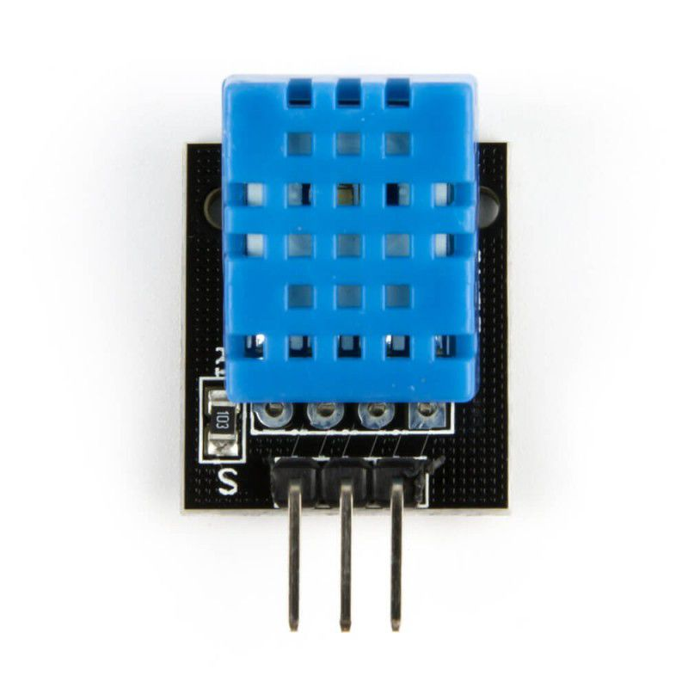
1. DHT11 Sensor
Simple & inexpensive
Consists of a capacitive humidity sensing element and a thermistor for sensing temperature
Outputs a digital signal on the data pin connected to the LCD display
Easy to operate

Slide 8
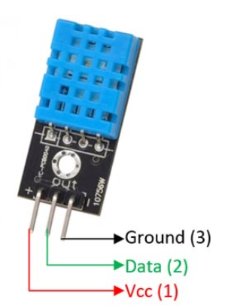
Specifications
Operating Voltage: 3.5V to 5.5V.
Operating current: 0.3mA (measuring) 60uA (standby)
Output: Serial data.
Temperature Range: 0°C to 50°C.
Humidity Range: 20% to 90%
Resolution: Temperature and Humidity both are 16-bit.
Accuracy: ±1°C and ±1%
(Components101, 2021)

Slide 9
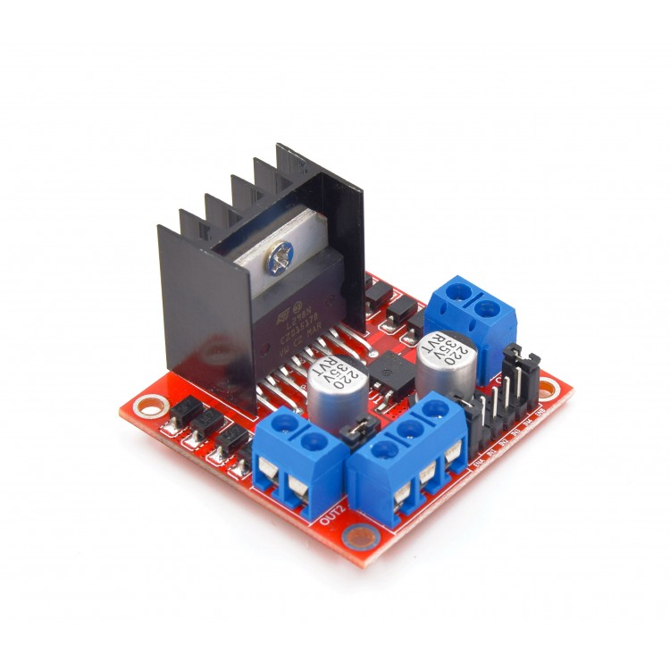
2. Motor Driver
Link between motor & control circuits
Converts low-current signal into a higher-current signal
Uses an H-Bridge to easily control the direction and speed of up to 2 DC motors
Feed PWM signals to the motor enable pins to control speed

Slide 10
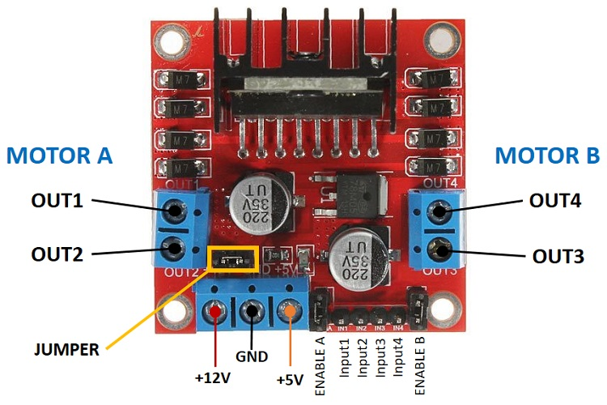
Specifications
Double H Bridge Drive Chip: L298N
Logical Voltage: 5V
Drive Voltage: 5V-35V
Logical Current: 0-36mA
Drive current: 2A (MAX single bridge)
Max Power: 25W
(Robotpark.com, 2015)

Slide 11
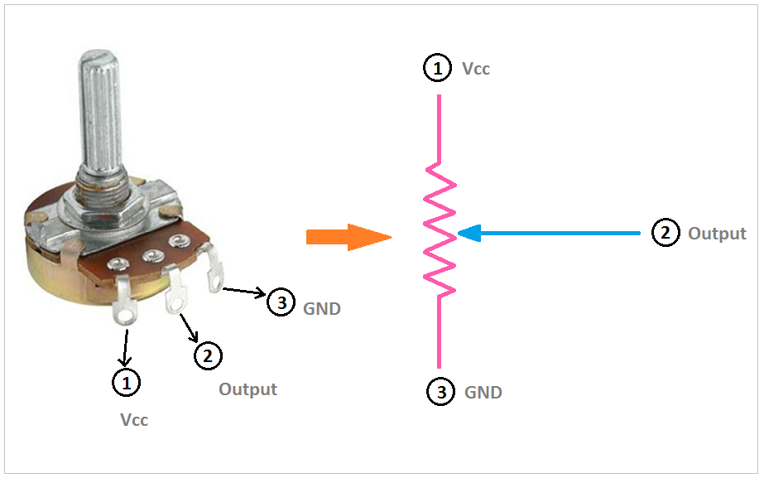
3. Potentiometer
Manually adjustable variable resistor with 3 terminals
Essentially functions as a variable resistance divider
Voltage is taken between a resistance end contact and the sliding contact

Slide 12
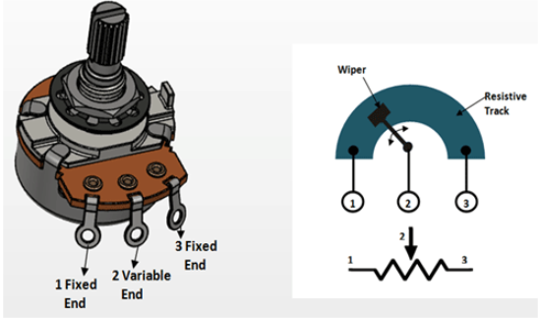
Specifications
Type: Rotary a.k.a Radio POT
Available in different resistance values like 500Ω, 1K, 2K, 5K, 10K, 22K, 47K, 50K, 100K, 220K, 470K, 500K, 1 M.
Power Rating: 0.3W
Maximum Input Voltage: 200Vdc
Rotational Life: 2000K cycles
‌(Components101, 2017)

Slide 13

4. Arduino Uno
Low-cost, flexible, and easy-to-use programmable open-source microcontroller board
Has 14 digital input/output pins (of which 6 can be used as PWM outputs), 6 analog inputs, a 16 MHz ceramic resonator, a USB connection, a power jack, an ICSP header and a reset button.

Slide 14
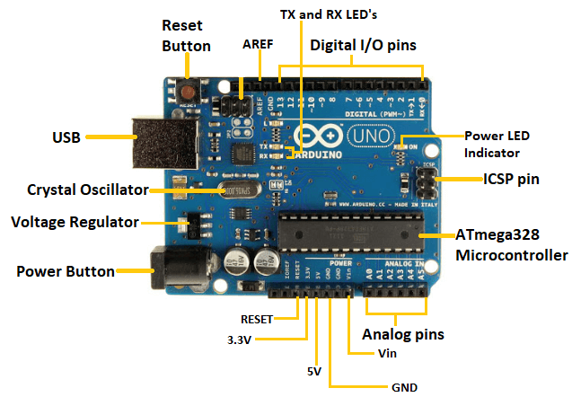
Specifications
Microcontroller: ATmega328P.
Operating Voltage: 5V.
Input Voltage (recommended): 7-12V.
Input Voltage (limit): 6-20V.
Digital I/O Pins: 14 (of which 6 provide PWM output)
PWM Digital I/O Pins: 6.
Analog Input Pins: 6.
DC Current per I/O Pin: 20 mA.
(TOMSON ELECTRONICS, 2018)

Slide 15
03.
Software Specifics

Slide 16
We decided to break the code down to the following parts:
Serial Monitor
LCD
Motor (Fan)
BLYNK

Slide 17
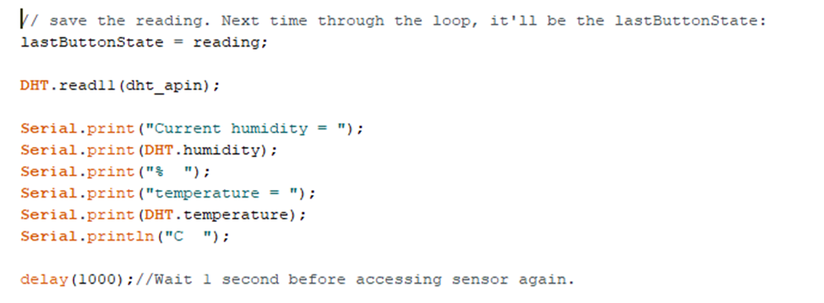
1. Serial Monitor: Foundation
This part of the code focuses on displaying the current temperature and humidity on the serial monitor of the ARDUINO application.

Slide 18
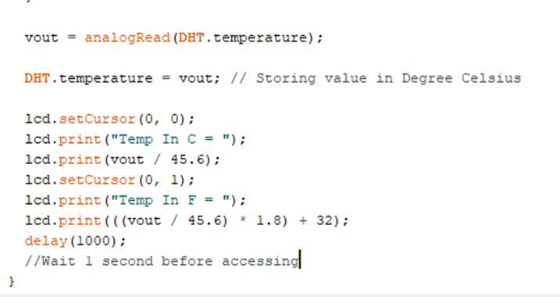
The next part of the code focuses on displaying the current temperature and humidity values, but this time, on an LCD 2x2 physical screen.
2. LCD

Slide 19
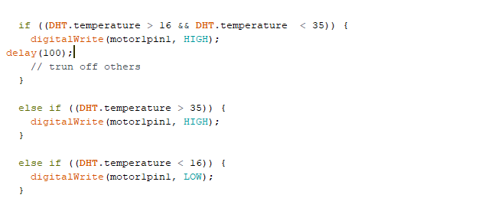
This is the most important part of the code because it controls the fan, and it has all the if statements
3. Motor: The fan

Slide 20
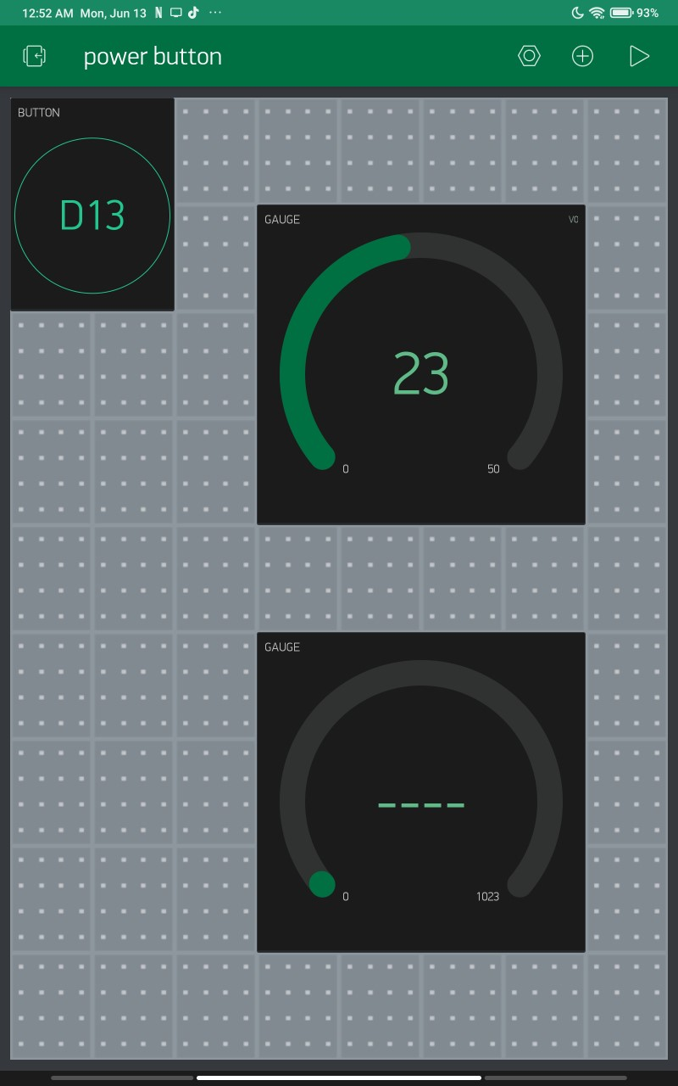
This section of the code is the associated with Blynk and has functionalities for the power button and the Live gauge.
4. BLYNK Application

Slide 21
04.
Construction Details
This cooling system unit has been assembled in such a way that it is less cluttered, with less wires and a cleaner appearance.
We attempted to model the cooling system's operation and create a virtual representation of it in Tinkercad and Multisim before beginning the assembly.
The assembly of the cooling system began after creating a virtual prototype, and we put everything together just as we had on Tinkercad.

Slide 22
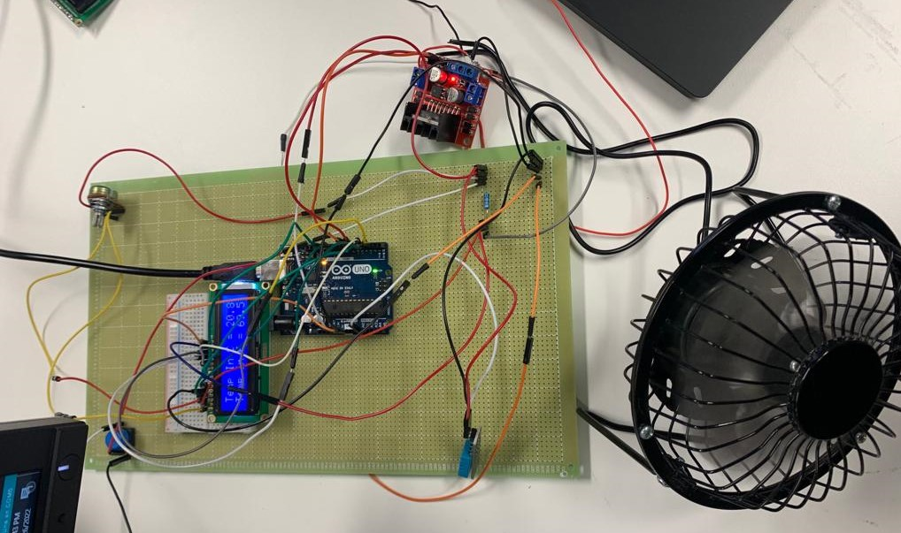
The Final Circuit

Slide 23
05.
Project stages and testing

Slide 24
PROJECT STAGES
Getting started with virtual prototype
A fully function smart cooling fan
Presenting our idea
Making a physical working prototype

Slide 25
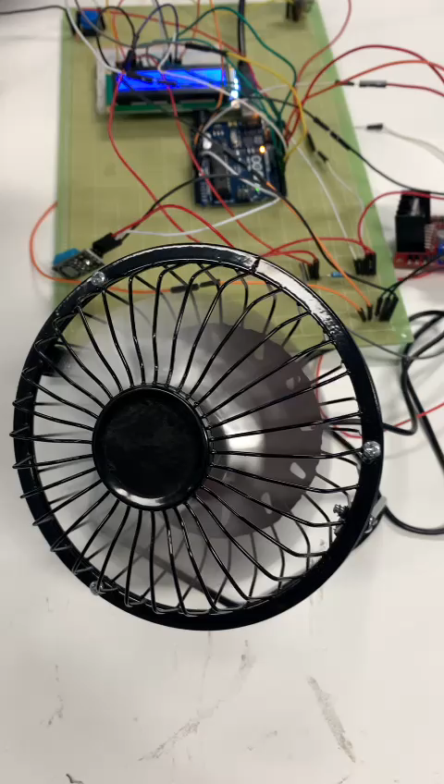
Testing Phase

Slide 26
06.
Marketing and Budget

Slide 27
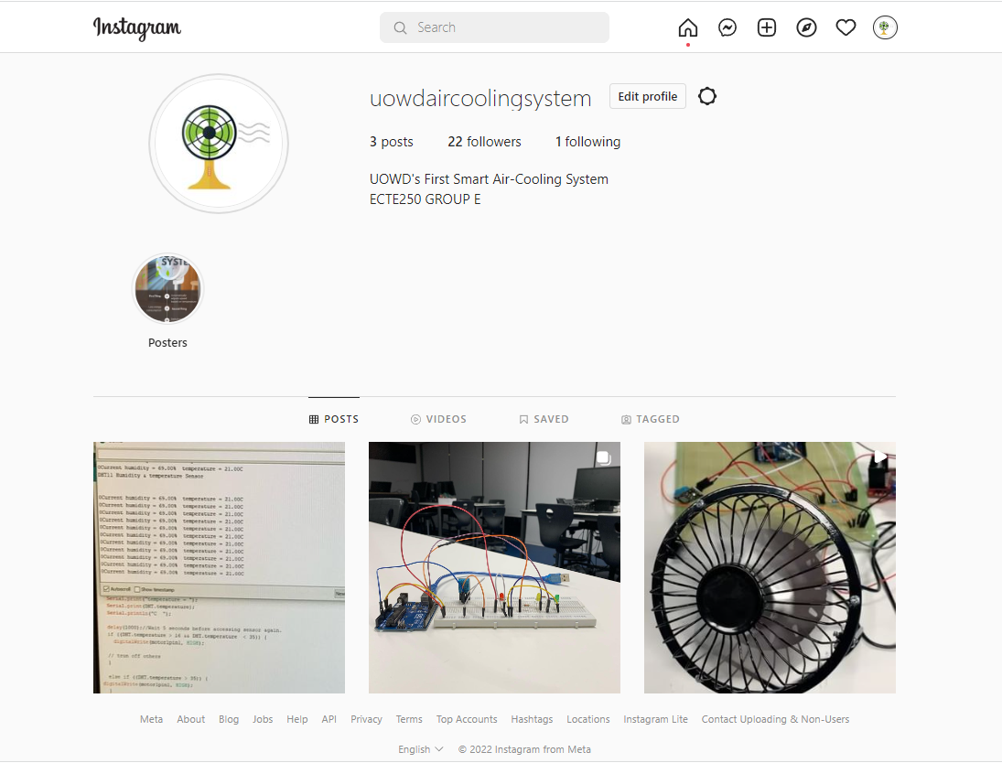



Marketing
@uowdaircoolingsystem
Social Media
Live ads
TV ads
News Paper

Slide 28

POSTER

Slide 29

Budget
Initial budget:
Estimated spending
900AED
800AED
Actual Spent
Savings
680AED
220AED

Slide 30
ACHIEVEMENTS
Understanding the market needs and promoting a product
Learning how to use BLYNK Application
1
3
5
2
4
Learnt how to integrate LCD
How to solder and use a perfoboard
How to combine all the components used in the project

Slide 31
OUR TEAM & ROLES IN PROJECT
Mahmoud
Zaid
Software part of
the design
Connections of
the design
Suraksha
Michael
Hardware components of the design
Blynk app layout
GROUP E

Slide 32
CONCLUSION
The smart cooling fan is an investment you should make right now to make your life simpler and more carefree for anything you want to use it for.

Slide 33
THANKS!
@uowdaircoolingsystem
Do you have any questions?

Slide 34
Refrences
Robotpark.com. (2015). L298N Dual H Bridge Motor Driver. [online] Available at: https://www.robotpark.com/L298N-Dual-H-Bridge-Motor-Driver [Accessed 15 Jun. 2022].
‌TOMSON ELECTRONICS. (2018). Arduino Uno Specification. [online] Available at: https://www.tomsonelectronics.com/blogs/news/arduino-uno-specification [Accessed 15 Jun. 2022].
Components101. (2017). Potentiometer. [online] Available at: https://components101.com/resistors/potentiometer [Accessed 15 Jun. 2022].
‌Components101. (2021). DHT11–Temperature and Humidity Sensor. [online] Available at: https://components101.com/sensors/dht11-temperature-sensor [Accessed 15 Jun. 2022].

